Slide 1


iSCSi-2022
Industry Sciences and Computer Sciences
ICT as the Key Enabling Technology in the age that
THINGS look learning
Luís Ferreira
lufer@ipca.pt
11-03-2022

Slide 2
Topics
Emerging ICT
Emerging new paradigms
Emerging a Déjà vu
Singularity

Slide 3
Yesterday Alan HevNer adverted that…
Society evolves
Science evolves
Technologies evolve
Human Values matter!
Ok,
but do Problems (seems to) also evolve?

Slide 4
All of us can clearly see that…
Yesterday was the future
Today will be the past
Tomorrow will be the present
Funny, isn’t it? ☺

Slide 5
First finding
Each new opportunity appears on the bases of previous (right or wrong) knowledge
If I have seen further, it is by standing on the shoulders of Giants
Isaac Newton, 1675

Slide 6
Second finding
The history of science is a history of our collective learning. Historians piece together different conversations to tell a story that crosses centuries and continents
Eman M. Elshaikh

Slide 7
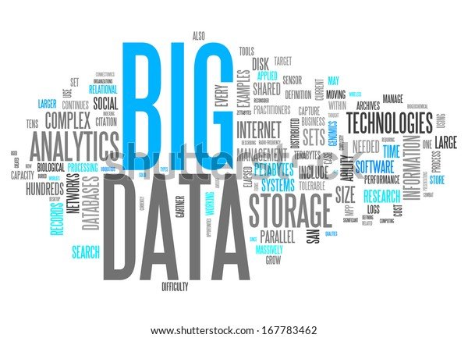
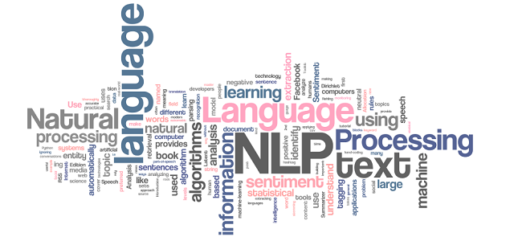
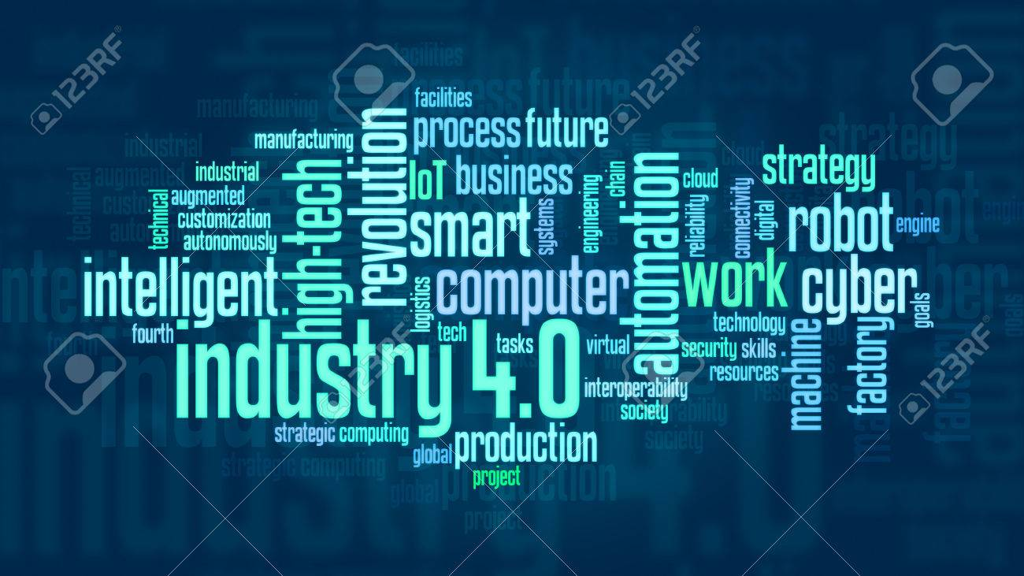

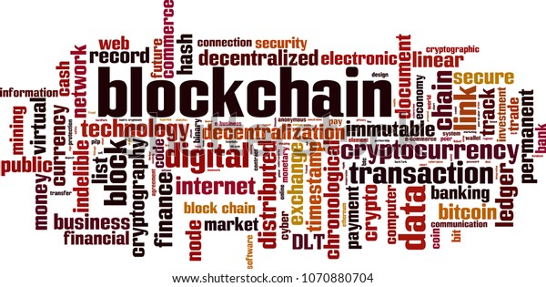
Third finding
Fashion Terms

Slide 8
ICT | Industries | Ecosystems “Techosystems”
Converging Technologies for Smart Environments and Integrated (eco)Systems!
Agile enterprises use “digital dexterity” to empower people to deal effectively with “dynamic, non-routine work.” (Gartner, 2015)
Innovation as competitive advantage
Innovation doesn’t always have to be rocket science. What’s more important is how we can create added value for the customer that meets his needs! (GF Piping Systems)
Rapid changes in technology…managers need to keeping up with it!
(2019 - 2022)?
Notes:
Balance
Equilibrium
Assumptions

Slide 9
ICT | Industries | Ecosystems
Picture a world where services are ubiquitous and organically integrated into the way we think and work. A place where both users and providers of information interact through a common focus on services. A world where technology is implemented within industry frameworks that operate on a global scale, enabled by open, interoperable standards….
Patrick J. Gannon – OASIS President&CEO (2003)

Slide 10
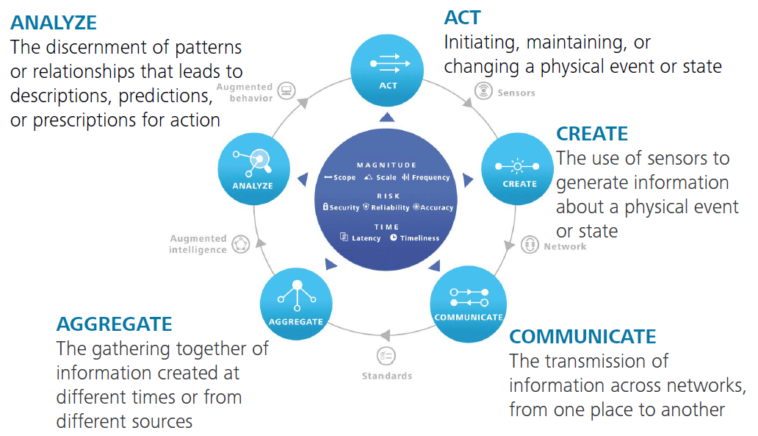
Industries | Echosystems
Magnitude | Risk | Time
Delloite
Notes:
A never-ending value loop
Azul claro – Stages
Azul escuro – Value Drivers
Cinzento – Technologies
Value-

Slide 11
Strategic Technology Trends
… rethinking of assembly line and supply chain processes to exploit 3D printing, Blockchain …?
Devices mesh
Ambient User Experience
3D Printing Materials
Information of Everything
Advanced Machine Learning
Automation
Autonomous Agents and Things
Adaptive Security Architecture
Advanced System Architecture
Mesh App and Service Architecture
Internet of Things Platforms
Intelligent and Digital Twins
… use autonomous things and agents to improve human activity and free people for work that only people can do…?
Notes:
The Device Mesh : cooperative interaction between devices to emerge.
Ambient User Experience : Immersive environments delivering augmented and virtual reality hold significant potential but are only one aspect of the experience – Immersive Environment - An artificial, interactive, computer-created scene or 'world' within which a user can immerse themselves! - The experience seamlessly flows across a shifting set of devices and interaction channels blending physical, virtual and electronic environment as the user moves from one place to another.
3D Printing Materials: including advanced nickel alloys, carbon fiber, glass, conductive ink, electronics, pharmaceuticals and biological materials - these advances will necessitate a rethinking of assembly line and supply chain processes to exploit 3D printing!
Information of Everything: Everything in the digital mesh produces, uses and transmits information - This information goes beyond textual, audio and video - Advances in semantic tools such as graph databases as well as other emerging data classification and information analysis techniques will bring meaning to the often chaotic deluge of information
Advanced Machine Learning: deep neural nets (DNNs) - systems that can autonomously learn to perceive the world, on their own - The explosion of data sources and complexity of information makes manual classification and analysis infeasible and uneconomic – Deep Learning – towards Artificial Intelligence!- Máquinas aprendem sem terem sido programadas! Make “smart machines” appear “intelligent”.
Autonomous Agents and Things: Machine learning gives rise to a spectrum of smart machine implementation (robots, autonomous vehicles, personal assistants, etc.)-While advances in physical smart machines…the software-based smart machines have a more near-term and broader impact - Instead of interacting with menus, forms and buttons on a smartphone, the user speaks to an app, which is really an intelligent agent - IT leaders should explore how they can use autonomous things and agents to augment human activity and free people for work that only people can do!
Adaptive Security Architecture: emerging "hacker industry" significantly increase the threat surface for an organization - Application self-protection, as well as user and entity behavior analytics.
Advanced System Architecture: The digital mesh and smart machines require intense computing architecture demands to make them viable for organizations - high-powered and ultra efficient neuromorphic architectures - Fueled by field-programmable gate arrays (FPGAs) - allowing advanced machine learning capabilities to be proliferated into the tiniest IoT endpoints.
Mesh App and Service Architecture: Monolithic, linear application designs (e.g., the three-tier architecture) are giving way to a more loosely coupled integrative approach: the apps and services architecture - Microservice architecture is an emerging pattern for building distributed applications that support agile delivery and scalable deployment - Application teams must create new modern architectures to deliver agile, flexible and dynamic cloud-based applications with agile, flexible and dynamic user experiences that span the digital mesh.
Internet of Things Platforms: IoT platforms complement the mesh app and service architecture - incomplete competing vendor approaches will make standardization difficult through 2018

Slide 12
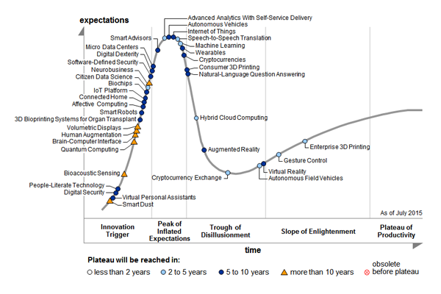
Technology Trends
Gartner

Slide 13
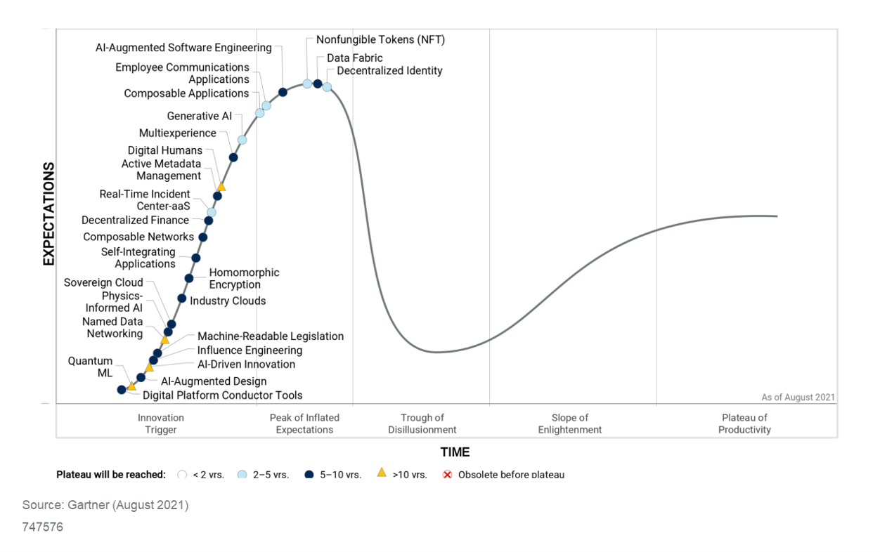
Technology Trends
Artificial Intelligence
Gartner

Slide 14
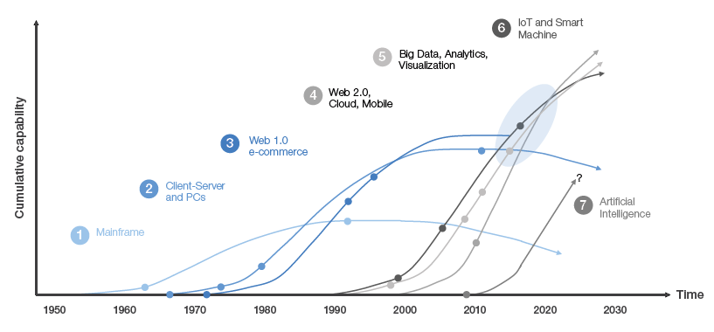
Technology Trends
[4]

Slide 15
Internet of Things (IoT)
“…intelligent interactivity between human and things to exchange information & knowledge for new value creation…”
(National IoT Blueprint)
& Services (IoTs)
Sensing and Monitoring (Edge Computing)
Ubiquity
Industry 4.0

Slide 16
More than Technology - Still lies in Human Experience
Internet of Everything, M2M, etc.
Ubiquitous Computing: (anything, anywhere, anytime, anyway….
any else?)
    Virtuality : Uncertainty and Reconfiguration
Collaboration (co-labor) and Cooperation (co-operate)
  Collectives collaborate;
  Connectives cooperate
Notes:
(VinOrg2015)
When collaborating, people work together (co-labor) on a single shared goal…. like an orchestra…each musician plays their part not for its own sake but to help make something bigger
When cooperating, people perform together (co-operate) while working on selfish yet common goals…If you help me I’ll help you
If an orchestra is the sound (melody) of collaboration, then a drum circle is the sound of cooperation
http://cloudhead.headmine.net/post/3279118157/cooperation-vs-collaboration
Collectives collaborate.
Connectives cooperate.

Slide 17
Big Data: some “petabyte” curiosities
The capacity of a human being's functional memory is estimated to be 1.25 terabytes. This means the memories of 800 human beings fit into one petabyte;
If you counted all the bits in one petabyte at one bit per second, it’d take 285 million years;
The Radio Telescope SKA (Square Kilometer Arrays - IBM), will generate 1,376 petabytes per day, twice daily global internet traffic.
Notes:
Light years in stars

Slide 18
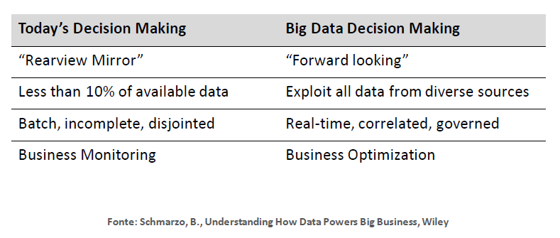
Big Data – Value creation for Industries
Notes:
Predictive Maintenance
Disruptive Technology

Slide 19
Big Data – Value creation for Industries
Notes:
Predictive Maintenance
Disruptive Technology

Slide 20
Big Data – Value creation for Industries
Effective Decision Making
  useful, timely, informed and sustainable decision!
Path to a Learning Factory:
  self-awareness, self-prediction, self-comparison, self-reconfiguration and self-maintenance.
Notes:
Predictive Maintenance
Effective Factory…more than smart factory!

Slide 21
Digital Factory
Digital Industry is based on cyber-physical production systems (CPS) that combine communications, IT, data and physical elements.
Machines "talk" to products and other machines, objects deliver decision-critical data, and information is processed and distributed in real time resulting in profound changes to the entire industrial ecosystem.

Slide 22
Path to Industry 4.0 and Smart Manufacturing
The foremost megatrends relevant for factories are globalization, progressing technological evolution, the dynamization of product life cycles, the aging work force and the shortage of resources. Central effects are the acceleration of innovation cycles and the increasing customer demand for individualized mass produces with highest quality expectations….^{[1]}
Smart Factory | Smart Manufacturing | Intelligent Factory | Factory of the Future

Slide 23
Challenges faced by I4.0
New Business Models - shift from selling products, to selling an integrated product and service – Product-Service System (PSS) - instead of a single product itself, provide their customers with services that are needed. In this relationship, the market goal of manufacturers is not one-time product selling, but continuous profit from customers by total service solution, which can satisfy unmet customers’ needs ^{[5]}
….release the human operator, engineer or manager from doing routine work…focus on defining the right strategy and goals to operate the factory effectively…^{[1]}
Notes:
Products with value-added services

Slide 24
Challenges faced by ALL these “new things”…
IoT device technical challenges
Lifetime and energy challenge
Data and information challenge
Humans and business models
Uncertainty appropriate responses
Notes:
Pag 162 de [1]

Slide 25
And inherent “Value Creation” for Industries…
visibility identification, location tracking
IoT-supported safety in hard industrial environments
right information providing or collecting
improved industrial operation and flows in industry
reduced production losses
reduced energy consumption
new type of processes made possible by IoT applications
new type of maintenance and lifetime approaches
enabled by smart objects, connected aspects
Sustainability
Others
data security, vigilance and resilience
Notes:
é possível imaginar que as fábricas do futuro contarão cada vez menos com a presença de seres humanos na linha de produção. Bom exemplo é a fábrica da Audi em Ingolstadt, na Alemanha, que tem cerca de 800 empregados e praticamente o mesmo número de robôs industriais, que fazem a maior parte do trabalho pesado e operacional.
o trabalho com a participação do ser humano tornou-se muito mais abstrato. As pessoas trabalham mais na resolução de problemas e menos na mera reprodução manual ou mecânica que acontecia no passado…
Delloite:
Securing data is critical at every stage of the value loop, especially the create and communicate stages
Remaining vigilant to new or unexpected challenges is crucial to maintaining security
A system’s resilience defines how quickly a realized risk can be addressed and normal operations restored

Slide 26
ICT & Industrial Engineering symbiosis
Web | Mobile | Cloud Computing | Big Data | IoT
Nanotechnology (functional nanomaterials & nanosensores & FPGA)
Highly cognitive and autonomous systems
Additive Manufacturing
Smart Predicting
AI : co-design and co-construction
Immersive Environments (AR/VR/MR)
Notes:
Field-Programmable Gate Arrays (FPGAs) – Hight power and ultra-efficient architectures

Slide 27
Main Challenges | Handicaps
Déjà vu
IT Integration and governance (virtual and ubiquitous)
Real-Time decision (exabyte of non structured data!...human relevance!)
IT Security Management
Innovation Management
Become a Learning Organizations | Learning Factory

Slide 28
FINAL FINDING:
Achieving certainty in a Uncertain World
Tangible Things
Formalization
Artificial Intelligence
No Tangible Things
Pragmatics
Humans
Notes:
Field-Programmable Gate Arrays (FPGAs) – Hight power and ultra-efficient architectures

Slide 29
FINAL FINDING:
Achieving certainty in a Uncertain World
Tangible Things
Formalization
Intelligence Amplification (IA)
No Tangible Things
Pragmatics
Humans
the path to
Technological Singularity
1993, Vernor Vinge
Notes:
Field-Programmable Gate Arrays (FPGAs) – Hight power and ultra-efficient architectures

Slide 30
Thanks | Obrigado
https://2ai.ipca.pt/
Luís Ferreira
lufer@ipca.pt

